Slide 1

Level Up Your MySQL Skills with This Real-World Problem
Explore, Query, and Manage Data Like a Pro
emamsaimon

Slide 2
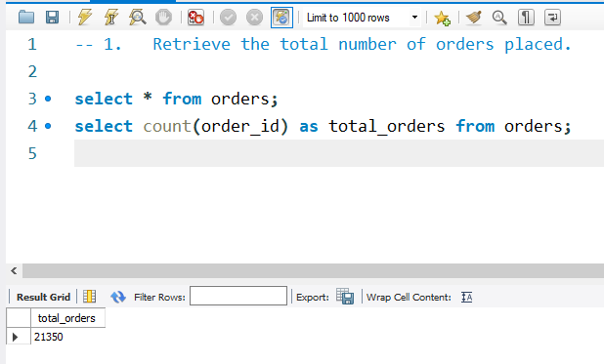
Basic
Retrieve the total number of orders placed.
emamsaimon

Slide 3
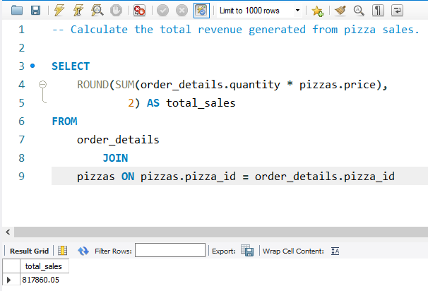
2. Calculate the total revenue generated from pizza sales.
emamsaimon

Slide 4
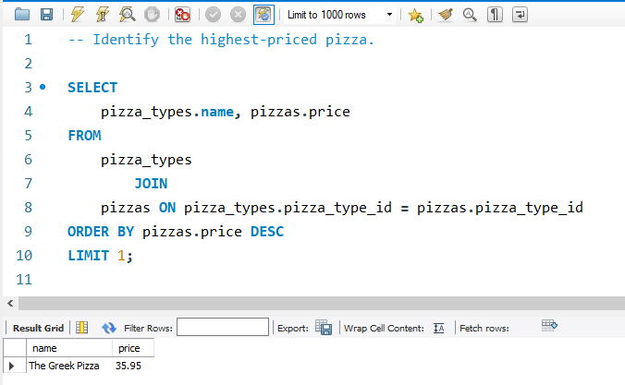
3. Identify the highest-priced pizza
emamsaimon

Slide 5
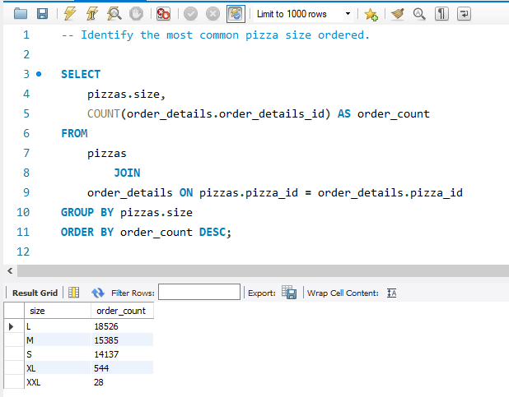
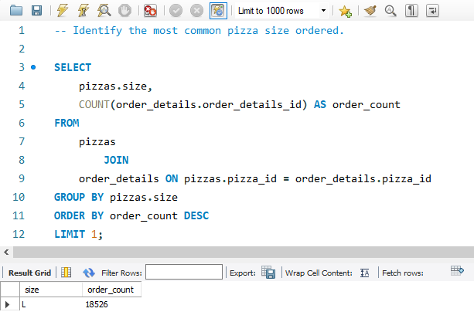
4. Identify the most common pizza size ordered.
emamsaimon

Slide 6
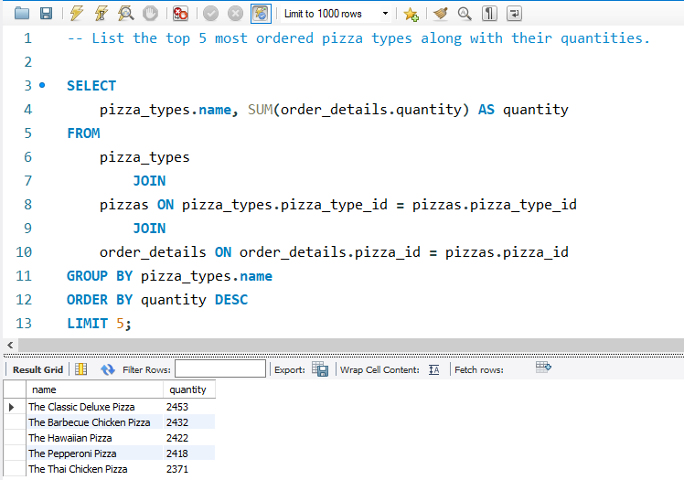
5. List the top 5 most ordered pizza types along with their quantities
emamsaimon

Slide 7
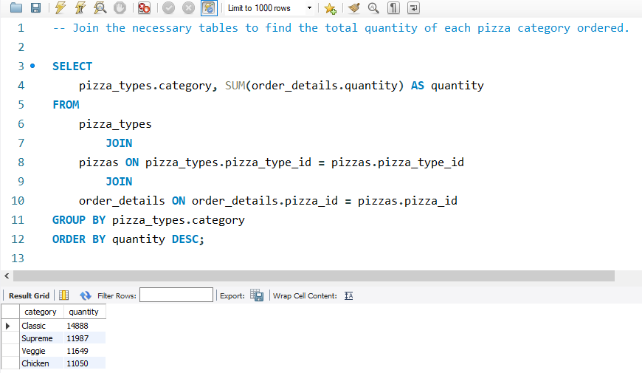
Intermediate
1. Join the necessary tables to find the total quantity of each pizza category ordered.
emamsaimon

Slide 8
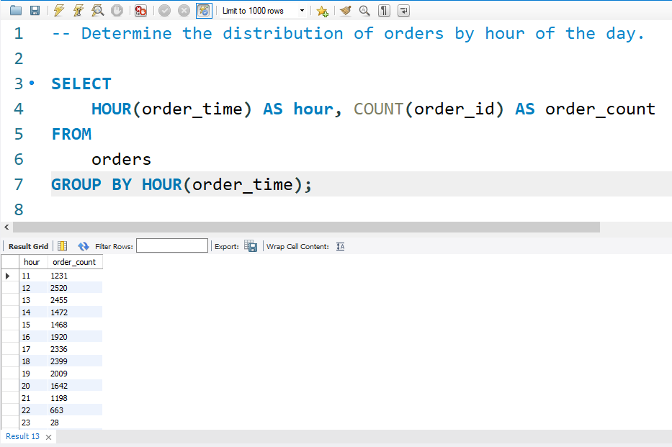
Intermediate
2. Determine the distribution of orders by hour of the day.
emamsaimon

Slide 9
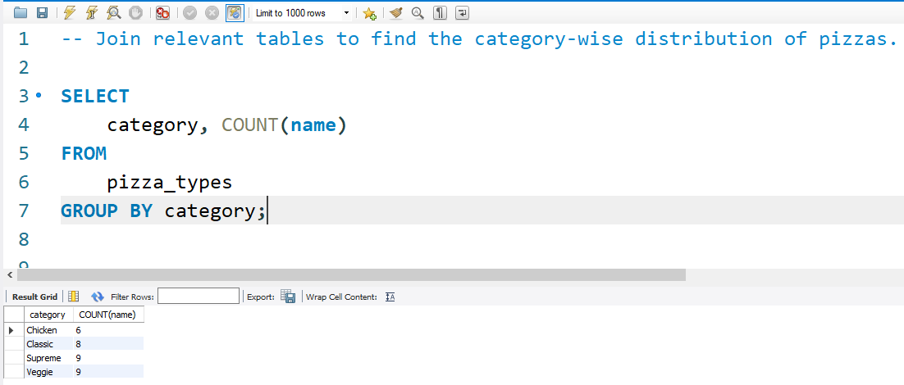
Intermediate
3. Join relevant tables to find the category-wise distribution of pizzas.
emamsaimon

Slide 10
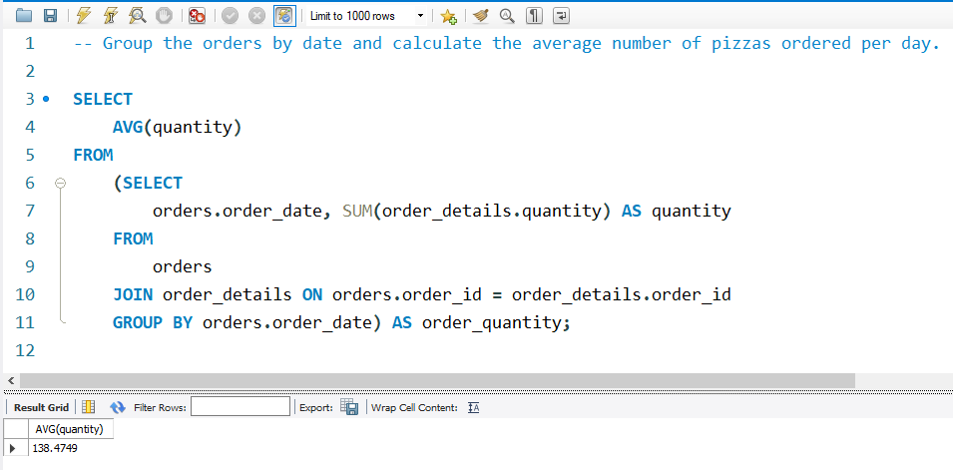
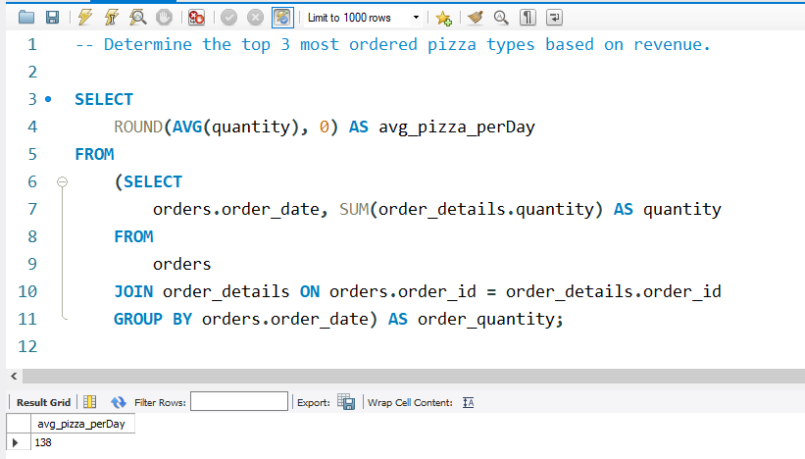
Intermediate
4. Group the orders by date and calculate the average number of pizzas ordered per day.
emamsaimon

Slide 11
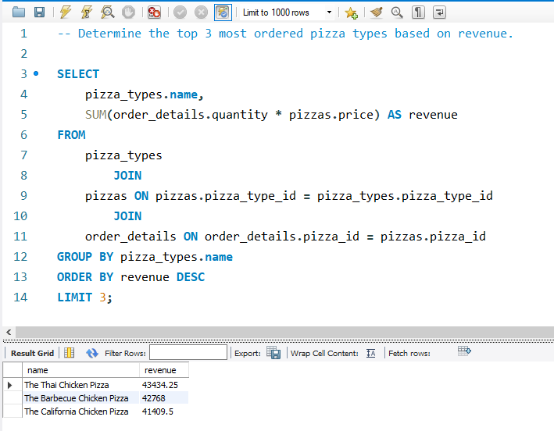
Intermediate
5. Determine the top 3 most ordered pizza types based on revenue.
emamsaimon

Slide 12
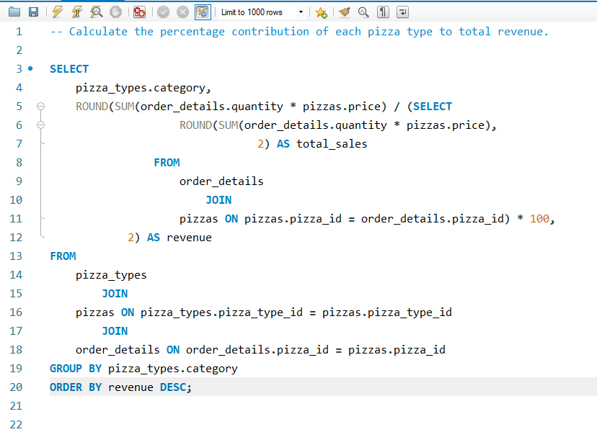
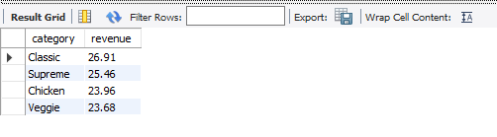
Advanced
1. Calculate the percentage contribution of each pizza type to total revenue.
emamsaimon

Slide 13
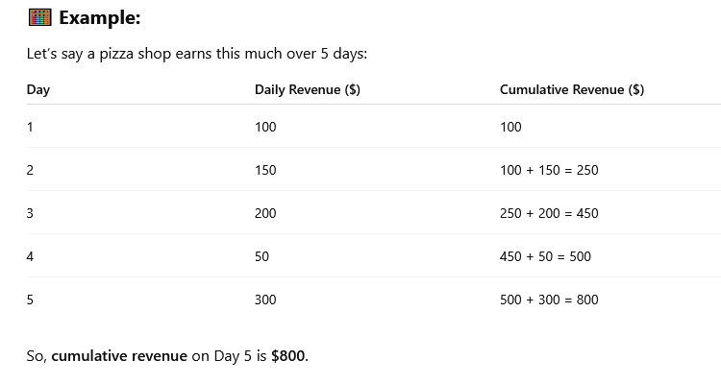
Advanced
2. Analyze the cumulative revenue generated over time.
Cumulative revenue means the total revenue collected up to a certain point in time, by adding all the previous revenues together.
Meaning in Simple Terms:
If you earn some money every day, your cumulative revenue is the total amount you've earned so far by adding all the daily revenues.
emamsaimon

Slide 14
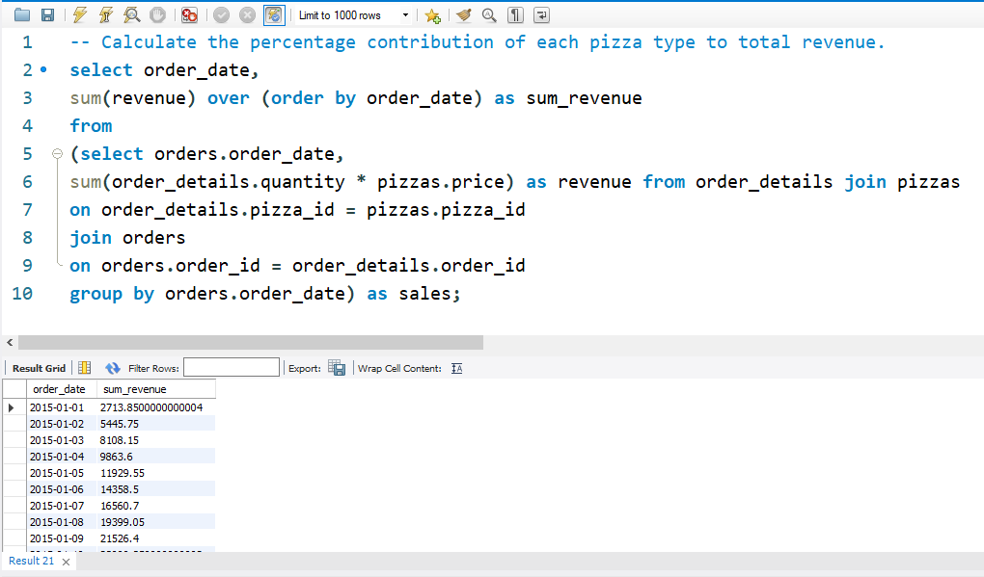
Advanced
2. Analyze the cumulative revenue generated over time.
emamsaimon

Slide 15
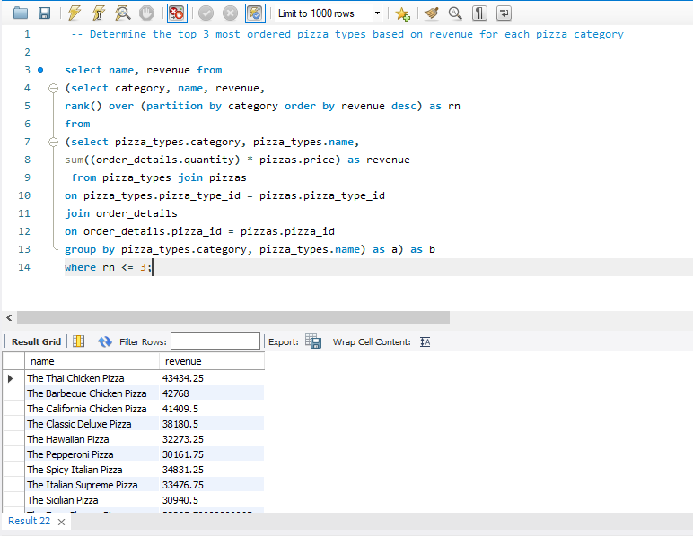
Advanced
3. Determine the top 3 most ordered pizza types based on revenue for each pizza category
emamsaimon

Slide 16


To find all Excel files in my GitHub repositories
emamsaimon

Slide 17


Slide 18


Slide 19
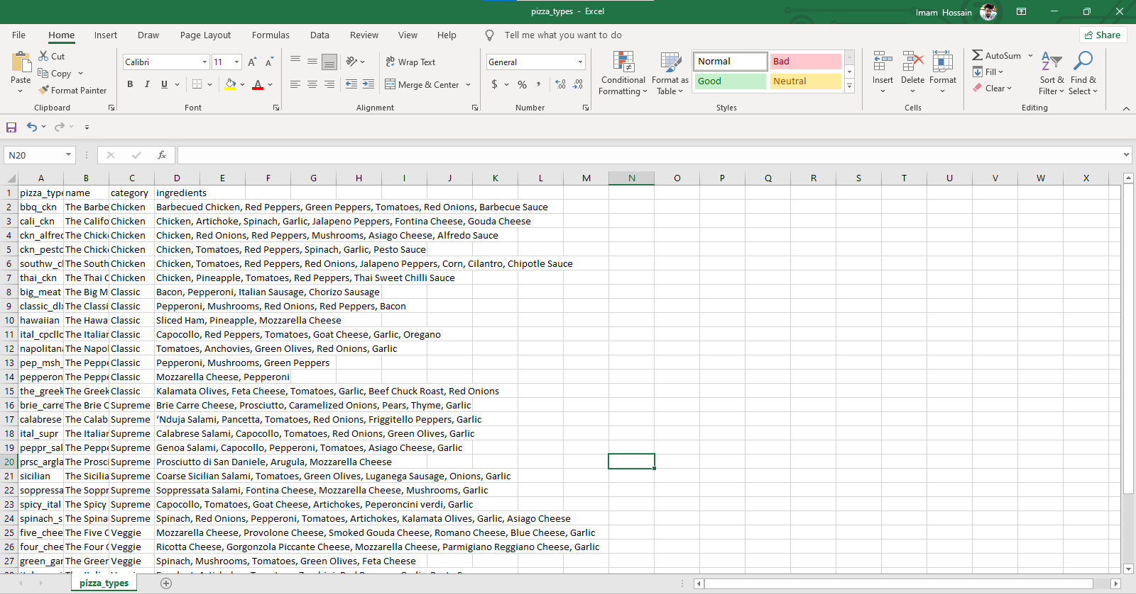

Slide 20


Slide 21


